Slide 1
Integrating Harm Reduction to Case Management Services
Tanagra M. Melgarejo
Chris Abert
Julie Rwan

Slide 2
Harm Reduction Coalition
Founded in 1993 by needle exchange providers, advocates, and drug users
Challenge the persistent stigma faced by people who use drugs
Advocate for policy and public health reform
Policy & Advocacy
Training & Capacity Building
Overdose Prevention & Advocacy
National & Regional Conferences
Resources & Publications
Harm Reduction Coalition creates spaces for dialogue and action that help heal the harms caused by racialized drug policies.

Slide 3
NYC CBA
NYC DOHMH’s Capacity Building Assistance project (NYC CBA) provides free and customized
training, technical assistance and culturally and linguistically appropriate information
to empower Community Based Organizations and Health Departments
to increase health equity.
HIV Testing
Policy
Prevention with HIV-Negative Persons
Condom Distribution
Prevention with HIV-Positive Persons
Harm Reduction
PrEP and PEP
HDs
CBOs
Navigation & Care Coordination
Outreach & Recruitment
Community Mapping
Follow up on today’s session:
Julie Rwan
jrwan@health.nyc.gov
Connect with us to learn more: NYCCBA@health.nyc.gov
Name-request NYC CBA by visiting www.getcbanow.org

Slide 5
INTRODUCTIONS
Name
Pronoun
Role
Expectation for the training

Slide 6
To provide an introduction to basic philosophy and practices of harm reduction and case management with regards to substance use and sexual risk behavior.
Workshop Goal
Notes:
The goal of this workshop is to provide an introduction to basic philosophy and practices of HIV/STI/HCV harm reduction with regards to substance use and sexual risk behavior.

Slide 7
Group Agreements
Step up, Step Back
Non-Judgment
Use “I” Statements
Agree to disagree
Confidentiality
WAIT/PUSH/ELMO
Notes:
TRAINERS INSTRUCTIONS:
We are talking about drugs and sex today.
Nobody is expected to talk about their own HIV/Hep C diagnosis, drug use, sexual practices or experiences with overdose, unwanted pregnancy, or treatment for STIs.
Are there other group agreements to add? (ex: cell phone or technical device use?)
KEY MESSAGES:
Step Up/Step Back:
Agree to Disagree: We all have own opinions.
WAIT: Why Am I Talking
PUSH or ELMO: Say PUSH, to “push” on training or Everybody Lets Move On

Slide 8
What is
Harm Reduction?
Harm Reduction Defined
Notes:
ASK:
What is Harm Reduction?
When you hear it, what first comes to mind in terms of providing services?
Options
Write down responses on Newsprint w. Thick Pen Markers
Or, ask if a volunteer would write down answers while you facilitate discussion
Or, have this discussion only
TRAINER INSTRUCTIONS:
Use this brainstorm as a way to open the training, getting a sense of what harm reduction means to participants, including their experiences with harm reduction.
This may be from a personal perspective (how harm reduction was -or was not- incorporated at their agency, or through their experience working as a peer/service provider).

Slide 9
Harm Reduction is…
A set of practical strategies that reduce the negative consequences of drug use and other risk behaviors
(ex: sexual risk).
In relation to drug use it incorporates a spectrum of strategies including safer use, managed use, abstinence.
Harm reduction strategies meet people "where
they're at“ (but don’t leave them there).
Notes:
TRAINER INSTRUCTIONS:
Explain how harm reduction has its roots in drug use, particularly injection drug use, we are going to discuss harm reduction within that context, while broadening it to apply to other risk behaviors or circumstances as it applies.
We will be going into further detail throughout the training to discuss various harm reduction approaches, interventions, and strategies that HHRNs can incorporate into their work with PWUD/PWID.
KEY MESSAGES:
Harm Reduction:
accepts that some ways of using are safer than others, and applies evidence-based interventions (i.e. syringe access, overdose prevention) to reduce negative consequences of drugs use (i.e. overdose fatalities, HIV/HCV transmission, injection-related wounds).
moves past judgment of another person to address their drug use and the harm that’s occurring to that person.
recognizes a continuum of use, modeling the stages of change theory.
is not making drug use acceptable; it’s accepting that people use drugs (pragmatic).
means meeting clients where they are, and also where the service provider is capable of being. Self care includes meeting yourself where you are at also.
works to ELICIT POSITIVE CHANGE (like motivational interviewing) based on individual client need, circumstance, and readiness to change.

Slide 10
A holistic approach to working with
people at higher-risk in relation to HIV,
drug use, and sexual behaviors.
Providers can be gatekeepers to
comprehensive care that is:
Convenient - Positive - Honest -
Productive - Client-centered - Pragmatic - Evidence-based - Without Bias
Notes:
KEY MESSAGES:
Providers probe into very private, personal and intimate details from the PLWHA/PWUDs we serve.
Because it’s holistic in nature, we can provide information & linkages to services that participants might otherwise never seek due to stigma, convenience (services under one roof), barriers (transportation costs), being undocumented, or not believing they were worth the self-care.
HARM REDUCTION PROGRAMS AIM TO BE LOW-THRESHOLD!
This means we reduce as many barriers as possible to meet the needs of an individual.

Slide 11
Risk Reduction, too
Employs various strategies and approaches to reduce individual physical and social harms associated with risk-taking behaviors.
Applies a holistic approach.
The degree of harm associated with a risk behavior may vary based upon numerous factors, including drug, set, and setting.
Notes:
NOTES:
Taken from studies of drug use but can be applied to other risk behaviors – useful when meeting people where they are.
Drug- the drug used, how it is used, how much is used, drug pharmacology, etc.
Set- mindset of the individual, influenced by demographic and social characteristics, as well as physical and mental health, interpersonal skills, etc.
Setting- the background, defined in terms of physical, social, economic, cultural
All of this in practice = a holistic approach.

Slide 12
The degree of harm associated with a risk behavior may vary based upon numerous factors, including drug, set, and setting.
Notes:
KEY MESSAGES:
Taken from studies of drug use but can be applied to other risk behaviors – useful when meeting people where they are.
Drug- the drug used, how it is used, how much is used, drug pharmacology, etc.
Set- mindset of the individual, influenced by demographic and social characteristics, as well as physical and mental health, interpersonal skills, etc.
Setting- the background, defined in terms of physical, social, economic, cultural
All of this in practice = a holistic approach.

Slide 13
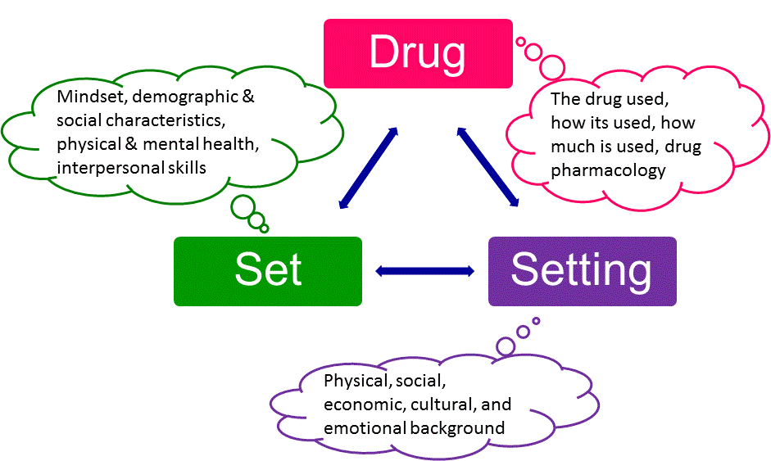
Zinberg, N. E. (1984) Drug, Set, And Setting: The Basis for Controlled Intoxicant Use (New Haven: Yale University Press)
Notes:
ASK: What is an example where a person’s DRUG, SET & SETTING could put them at higher risk of Overdose?
Reference:
Zinberg, N. E. (1984) Drug, Set, And Setting: The Basis for Controlled Intoxicant Use (New Haven: Yale University Press) ISBN 0-300-03110-6

Slide 14
Continuum of Use
Experimental Use
Situational Use
Abuse
Severely and Persistently Chemically Dependent
Social & Ritual Use
Binge Use
Dependence
Notes:
TRAINERS NOTES:
People can move back and forth along this continuum.
Or be somewhere with one drug and another place w. a different drug.

Slide 15
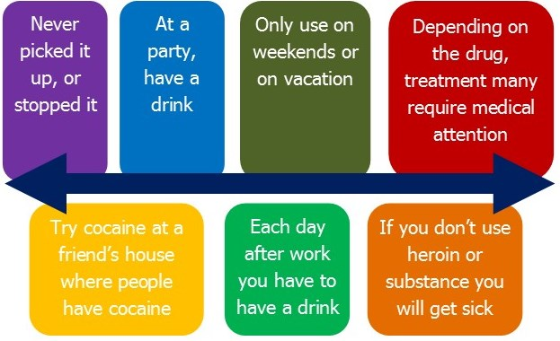
For Example

Slide 16
What Harm Reduction is Not
Harm reduction does not mean “anything goes.”
Harm reduction does not enable drug use or high risk behaviors.
Harm reduction does not condone, endorse, or encourage drug use.
Harm reduction does not exclude or dismiss abstinence-based treatment models as viable options.

Slide 17
The Problem
Focus on criminalization rather than treatment
Traditional drug treatment is not always viable or successful
Syndemic of HIV, Hep C, and overdose
Continued drug user stigma
Notes:
Define SYNDEMIC

Slide 18
Why Is There A Need For
Harm Reduction?
Reduce Drug User Stigma
Increase Trust and Improve Engagement with Clients
Improve Individual and Community Health

Slide 19
What are factors related to a person who uses drugs?
Notes:
ASK: “What are other factors related to a person who use drugs?”
KEY MESSAGES:
Other factors include
Hygiene – if a person has access to soap and water and keeping themselves, their clothing, and environment clean or without contamination
Poor water supply – if there is sterile or running water available to dissolve the drugs
What type of drug – if it is powder, pills, gooey “black tar”, cocaine or methamphetamine
How long the drug continues to take effect – ‘short or long high’ (ex: cocaine is short high, possibly requiring more frequent use to sustain effect
What the drug is cut with – household cleaners or otherwise poisonous and not designed for human consumption
Using used needles – only have one left (confiscated, busted, hadn’t a chance to visit NEP, no where to put a grip of gear (homeless, on foot))
19

Slide 20
Six Domains of
Psychosocial Function
Physical
Psychological
Social
Economic/
Vocational
Legal
Spiritual
Notes:
These domains can be considered in terms of the reasons people use drugs as well as in terms of the harms associated with using drugs.
Reasons to use drugs:
Physical- pleasure, coping
Psychological- pleasure, coping
Social- exchange, social lubricant
Economic- cheaper than healthcare, allows one to maintain employment
Legal- it is legal, less illegal
Political- N/A
Harms associated with using drugs:
Physical- HIV, hepatitis C, overdose
Psychological- mental illness, psychosis
Social- compromised relationships, social stigma and isolation
Economic- loss of money, employment, public benefits
Legal- arrest, incarceration
Political- loss of political power- voting, representation

Slide 21
Contributing Factors & Harms
Physical
    Poor health outcomes
    Violence
    OD
Psychological
    Depression
    Isolation
    Stigma
Social
    Relationship issues
    Lack of community
    Isolation from community
Spiritual
    Isolation
    Not connecting to life
Economic
    $ to acquire drugs
    Loss of housing
    Loss of or trouble finding jobs
Legal
    Discrimination
    Arrest
    Incarceration
Notes:
Re-cap about how Contributing Factors & Harms all interconnected.

Slide 22
Principles of Harm Reduction
      Health and Dignity
      Participant-centered Services
      Participant Involvement
      Participant Autonomy
      Sociocultural Complexity
      Pragmatism/Realism
Notes:
22

Slide 23
Activity Instructions
Key Principles
Health and Dignity
Participant-Centered
Participant Involvement
Participant Self-Rule
Recognize Inequalities & Injustices
Practical and Realistic
When the Trainer calls it out, move to the Principle that for you:
Resonates
Is the most Challenging
Notes:
Leave slide up during Activity
TRAINER INSTRUCTIONS
You have asked workshop participants to get up and move to the Principle on the wall that RESONATES with them.
In other words, go to the Principle you related the most with.
De-Brief Options
Do not let participants stand more than 7-10 minutes. Tell them to return to their seats.***
ACTIVITY INSTRUCTIONS
Explain Part 1 of the Activity
Keep the next slide up during the Activity (part 1 and 2)
The Principles of Harm Reduction are posted around the room.
1-- Ask people to get up and move to move to the Principle that resonated with them the most.
Discuss what made this principal resonate with them.
B--Ask participants to move to the Principle that they find the most challenging
Discuss what made this principal challenging.
De-Brief
After each A and B, ask why people chose that Principle.
Go through each principle
Time depending, 1- 3 people each principle

Slide 24
What is Case Management?
"A collaborative process that assesses, plans, implements, coordinates, monitors and evaluates the options and services required to meet the client’s health and human services needs. It is characterized by advocacy, communication, and resource management and promotes quality and cost-effective interventions and outcomes”
(CCMC, 2010).

Slide 25
What is Case Management?
GOAL: To meet individuals’ and families comprehensive health needs and enhance overall wellness
Collaborative Process of Goal Setting
Care Coordination
Continuity of Care
Enhance Accessibility & Accountability of Services
Foster Client Autonomy
Enhance efficiency of service delivery

Slide 26
5 Functions of Case Management
1. Assessment
2. Planning
3. Linking
4. Monitoring
5. Evaluation

Slide 27
The most successful case management practices are those which are carefully adapted to take into account needs, constraints, and resources of our program and our participants.

Slide 28
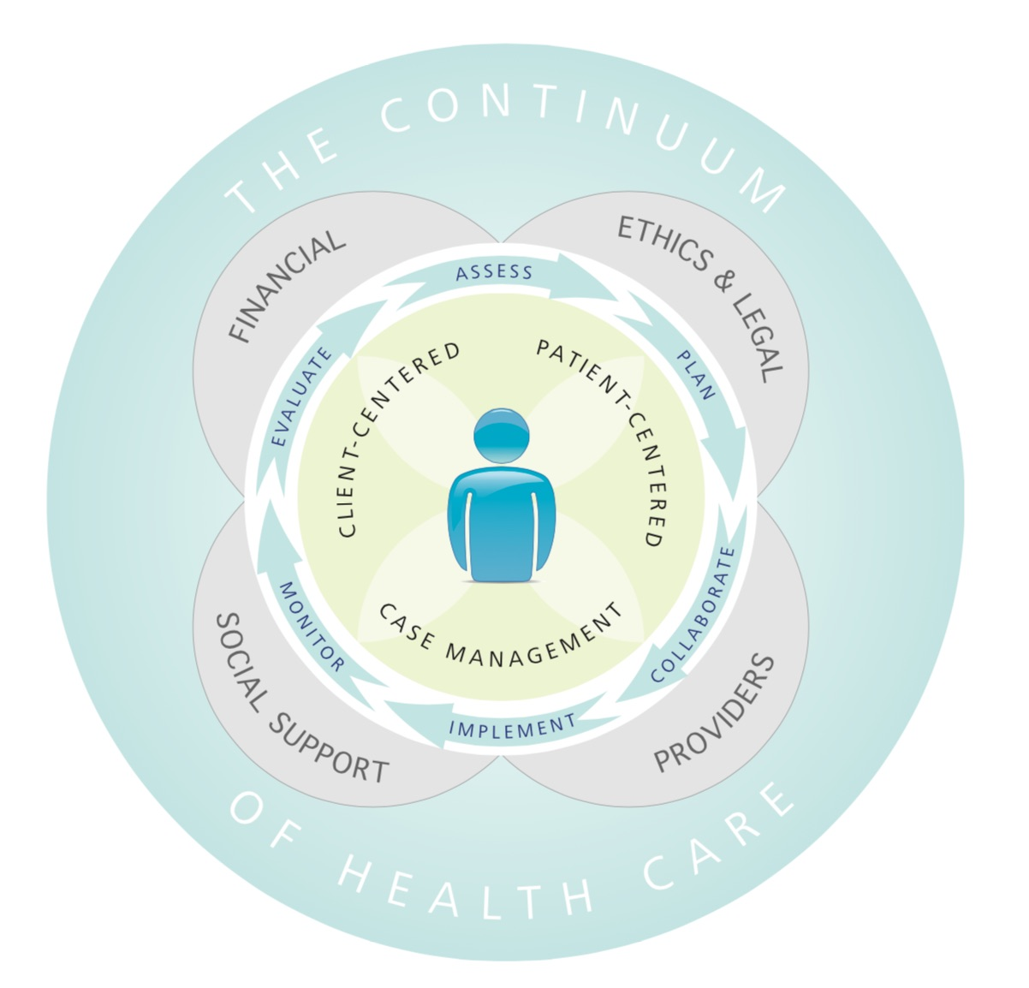

Slide 29
Models of Case Management

Slide 30
3 Models for
Case Management Programs
Comprehensive Model
Outreach
Client assessment
Case planning
Referral to service providers
Advocacy for Client
Direct Casework
Developing Natural Support Systems
Reassessment
Advocacy for Resource Development
Monitor Quality
Public Education
Crisis Intervention
Coordination Model
Outreach
Client assessment
Case planning
Referral to service providers
Advocacy for Client
Direct Casework
Developing Natural Support Systems
Reassessment
Minimal Model
Outreach
Client assessment
Case planning
Referral to service providers

Slide 31
Case Management Guiding Principles
Use a client-centric, collaborative partnership approach.
Whenever possible, facilitate self-determination and self-care through the tenets of advocacy, shared decision-making, and education.
Practice cultural competence, with awareness and respect for diversity.
Use a comprehensive, holistic approach.

Slide 32
Promote the use of evidence-based care, as available.
Promote optimal client safety.
Link with community resources.
Assist with navigating the health care system to achieve successful care, for example during transitions.

Slide 33
Pursue professional excellence and maintain competence in practice.
Promote quality outcomes and measurement of those outcomes.
Support and maintain compliance with federal, state, local, organizational, and certification rules and regulations.

Slide 34
Goal setting through an HR lens in Case Management

Slide 35
The client is the expert in their own life.
The client is responsible for choosing the type and timing of their own behavior change.
Notes:
TRAINER INSTRUCTIONS
Read the slide.
TRAINER INSTRUCTIONS
Encourage people to think beyond one idea or definition of “drug use” and “drug user” where drugs are placed in a “good/bad” dichotomy.
Try to move away from presumptions that there is a single or definable drug user experience.
NOTES
Some people might suggest another approach such as providers should tell the person to stop using drugs altogether.
There are two problems with this approach.
Many people don’t experience this as encouragement may cut off their relationship with the provider.
Ex: “If you’re a smoker, and every time I see you, I say, “You know, that’s really bad for you,” you’re not going to avoid smoking, you’re going to avoid me.”
2) Even clients who are committed to abstinence need this information.
Ex: If a person has abstained from heroin for many months and then goes out to get the drug, they might inject the same amount of heroin they did when using regularly.
This can lead to fatal overdose, because during the time of abstinence, their tolerance levels have gone down.
From the “Trainer’s Manual – An Overview of Harm Reduction in African American Communities.” Harm Reduction Training Institute.

Slide 36
Provider Tips
Observations should guide, not dictate, the encounter.
What a client feels they need one day can change the next.
Give yourself a moment between clients so a challenging encounter does not tarnish your attitude with the next client.
Talk about what the person is doing right.
Respect the intimacy of an encounter.
The presenting issue is rarely the only issue.
Notes:
KEY MESSAGES
Tips for providers who want to incorporate harm reduction skills into their relationships with clients, more effectively.
Observations should guide, not dictate, the encounter.
What a client feels they need one day can change the next.
Give yourself a moment between clients so a challenging encounter does not tarnish your attitude with the next client.
Talk about what the person is doing right.
Respect the intimacy of an encounter.
The presenting issue is rarely the only issue.

Slide 37
Key Case Management Principles through a Trauma Informed Lens
Safety
2. Trustworthiness and Transparency
3. Peer support

Slide 38
Key Case Management Principles through a Trauma Informed Lens
4. Collaboration and mutuality
5. Empowerment, voice and choice
6. Cultural, Historical, and Gender Issues

Slide 39
Goal setting through a HR lens in Case Management
Takes in to consideration participant autonomy.
Promotes self-efficacy by focusing on concrete attainable goals (focus on short term without losing sight of long-term).
Practical and focused on the person’s current reality and needs.

Slide 40
Goal setting through a HR lens in Case Management
Meet people where they are at and where you are able to meet them at (takes into account the confines of structures)
Flexibility is a must. Offer several possible options for the participant to chose from.

Slide 41
Tips for applying HR to Case Management
Use the principles of the harm reduction
Provide non- judgmental education, support, and evidence-based interventions
Use active listening
Provide supplies and education tailored to individual risk and need
Engage individuals in the community about your organization in a safe and neutral setting
Notes:
KEY MESSAGES
Using the principles of the harm reduction, provide non- judgmental education, support, and evidence-based interventions.
Remember that everyone’s experiences are different -listen.
Provide harm reduction supplies and prevention education tailored to individual risk and need.
Engage individuals in the community about your organization in a neutral and safe setting.

Slide 42
Ensure you have appropriate skills & information
Adhere to the guidelines of your program
Maintain participant/provider boundaries
Take care of yourself
Notes:
KEY MESSAGES
Accept that individuals have a right to make their own decisions, manage their own lives, in their own way.
Ensure you’re equipped with appropriate skills & information.
Understand how to recognize & support incremental behavioral change.
Adhere to the guidelines of you program & maintain participant/provider boundaries.
Take care of yourself; be mindful of your personal needs.

Slide 43
To recognize incremental behavioral change
Be mindful of your personal needs
Accept that individuals have a right to make their own decisions and manage their own lives, in their own way.

Slide 44
Harm Reduction and Case Management
Practical strategies and interventions

Slide 45
Tips for applying HR to Case Management
Use the principles of the harm reduction
Provide non- judgmental education, support, and evidence-based interventions
Use active listening
Provide supplies and education tailored to individual risk and need
Engage individuals in the community about your organization in a safe and neutral setting
Notes:
KEY MESSAGES
Using the principles of the harm reduction, provide non- judgmental education, support, and evidence-based interventions.
Remember that everyone’s experiences are different -listen.
Provide harm reduction supplies and prevention education tailored to individual risk and need.
Engage individuals in the community about your organization in a neutral and safe setting.

Slide 46
Ensure you have appropriate skills & information
Adhere to the guidelines of your program
Maintain participant/provider boundaries
Take care of yourself
Notes:
KEY MESSAGES
Accept that individuals have a right to make their own decisions, manage their own lives, in their own way.
Ensure you’re equipped with appropriate skills & information.
Understand how to recognize & support incremental behavioral change.
Adhere to the guidelines of you program & maintain participant/provider boundaries.
Take care of yourself; be mindful of your personal needs.

Slide 47
To recognize incremental behavioral change
Be mindful of your personal needs
Accept that individuals have a right to make their own decisions and manage their own lives, in their own way.

Slide 48
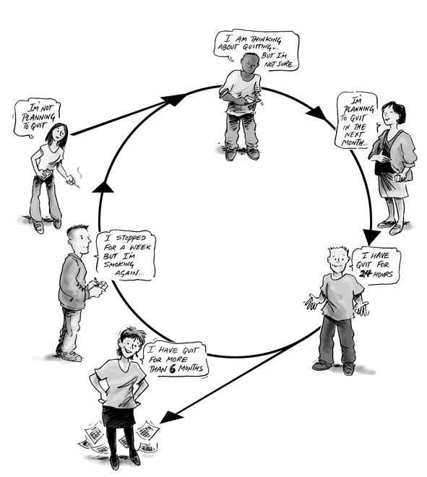
Stages of (Behavior) Change
Harm Reduction applies MI as a means to assist participants to identify where they are in terms of their drug use & risk behaviors then offering harm reduction interventions, approaches & materials at each stage

Slide 49
PRE-CONTEMPLATION “Not Considering”
CONTEMPLATION “Thinking About It”
PREPARATION “Planning To Do It”
ACTION “Doing It”
MAINTENANCE “Staying With It”
RETURN/RELAPSE “Stop Doing It”
Notes:
TRAINERS INSTRUCTIONS
Use same thread for the 6 stages: smoking cigarettes, for example:
PRE-CONTEMPLATION “Not Considering It” – I buy a pack of smokes in the morning and have a few with my coffee
CONTEMPLATION “Thinking About It”-- I hear smoking kills, I know this, I’m just starting to think to slow down maybe
PREPARATION “Planning To Do It” -- I got a plan: I chew that gum for 2 weeks, I stop smoking before 12 noon, I have an end-date
ACTION “Doing It” – I’m not smoking, one day at a time!
MAINTENANCE “Staying With It” – Some say you need 6 months of doing something for real before you hit ‘maintenance’
RETURN/RELAPSE “Stop Doing It”-- – Lapse is doing that one thing maybe once, ReLapse is when you resume the behavior; I bum a smoke from a gal at a party after having not smoked for 6 months (Lapse), I start buying a pack in the morning to go with my coffee (ReLapse). Re/Lapse can come in handy to re-calibrate Preparation: maybe I can’t handle coffee without cigarettes so my next run at this includes drinking tea in the morning (Action) til I feel confident I can have the coffee without cigarettes for two seasons (welcome back to Maintenance)
49

Slide 50
Stages of Change
ACTIVITY
Notes:
TRAINERS PREP
Prepare newsprint strips with the names of each Stage of Change and tape each SoC around the room.
TRAINERS INSTRUCTIONS
Explain the Activity
Use a health example that is not focused on sex, drugs, or something intensely personal and allow the room to get a feel of each SoC
You have already posted the six (6) SoC titled newsprints around the room.
While everyone is seated, ask them to think at what SoC there are at with eating a green, leafy salad every day. (Bean salads don’t count;)
Then ask them to get up and go stand in front of the SoC that is a match for where there are at with eating a green, leafy salad every day.

Slide 51
Green Leafy Salad Activity
Which Stage of Change are you in for Eating a Green Leafy Salad Everyday?
PRE-CONTEMPLATION “Not Considering It”
CONTEMPLATION “Thinking About It”
PREPARATION “Planning To Do It”
ACTION “Doing It”
MAINTENANCE “Staying With It”
RETURN/RELAPSE “Stop Doing It”
Notes:
Keep this slide up during the Activity
De-BRIEF
When everyone is standing in front of their particular SoC,
Ask each group why they were at that particular stage
Ask each stage what it would take to move them to the next stage – or for Maintenance, what would help keep them there.

Slide 52
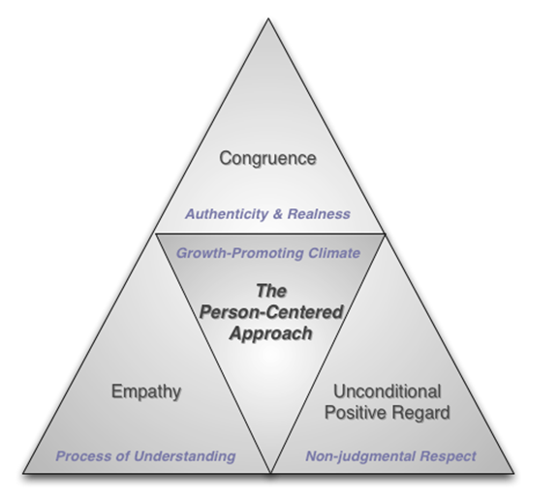

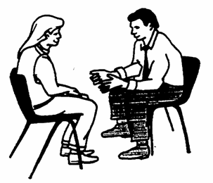
Motivational Interviewing
A Person-Centered Approach
MI is a collaborative, goal-oriented & person-centered counseling style that helps to resolve client ambivalence about health behavior change by building intrinsic motivation and strengthening commitment.
(Miller & Rollnick, 2002)

Slide 53

5 Clinical Principles
of Motivational Interviewing
Express Empathy
Roll with Resistance
Support
Self-Efficacy
Avoid Argumentation
Develop Discrepancy

Slide 54
4 Clinical Strategies
of Motivational Interviewing
Open-Ended Questions
Reflective Listening
Summaries
Affirmations

Slide 55
Putting all together
Case Studies

Slide 56
Next steps for you as case manager?
Next steps for your organization?
Notes:
Commitment to integrating HR to their daily practice—personally
Commitment from their org to rethinking/offering case mgt services through a HR lens

Slide 57
HRC thanks you for participating in this workshop!

