Slide 1
Harm Reduction Overview
Tanagra M. Melgarejo
Chris Abert
Michael Diaz
Notes:
TRAINER INSTRUCTIONS
Welcome!
This is a half-day overview on Harm Reduction with a focus on People Who Inject Drugs (PWID)
The workshop is 3 hours with one scheduled 15 min break.

Slide 2
Harm Reduction Coalition
Founded in 1993 by needle exchange providers, advocates, and drug users
Challenge the persistent stigma faced by people who use drugs
Advocate for policy and public health reform
Policy & Advocacy
Training & Capacity Building
Overdose Prevention & Advocacy
National & Regional Conferences
Resources & Publications
Harm Reduction Coalition creates spaces for dialogue and action that help heal the harms caused by racialized drug policies.

Slide 3
NYC CBA
NYC DOHMH’s Capacity Building Assistance project (NYC CBA) provides free and customized
training, technical assistance and culturally and linguistically appropriate information
to empower Community Based Organizations and Health Departments
to increase health equity.
HIV Testing
Policy
Prevention with HIV-Negative Persons
Condom Distribution
Prevention with HIV-Positive Persons
Harm Reduction
PrEP and PEP
HDs
CBOs
Navigation & Care Coordination
Outreach & Recruitment
Community Mapping
Follow up on today’s session:
Julie Rwan
jrwan@health.nyc.gov
Connect with us to learn more: NYCCBA@health.nyc.gov
Name-request NYC CBA by visiting www.getcbanow.org

Slide 4

The NYC DOHMH’s Capacity Building Assistance (CBA) program works to empower organizations and increase health equity through:
  •Training
  •Technical assistance
  •Culturally and linguistically appropriate information
We support:
For more information contact us at: NYCCBA@health.nyc.gov
Submit a request by visiting getcbanow.org
Category | Components
A: Health Departments | HIV testing, Policy, PWN
B: Community Based Organizations | Condom Distribution, HIV Testing, PWP, PWN
Melanie Graham, MSW
CBA Project Director
mgraham6@health.nyc.gov
Julie Rwan, MPH
Intervention Specialist
jrwan@health.nyc.gov

Slide 6
INTRODUCTIONS
Name
Pronoun
Role
Expectation for the training

Slide 7
Group Agreements
Step up, Step Back
Non-Judgment
Use “I” Statements
Agree to disagree
Confidentiality
WAIT/PUSH/ELMO
Notes:
TRAINER INSTRUCTIONS
We are talking about reducing harms related to drug use and sexual betoday, so this workshop might bring up sensitive topics for some workshop participants.
Nobody is expected to talk about their own drug use and sexual behaviors.
Use the training to ask questions and discuss concerns.
It will be important to be respectful of each other during this time.
Are there other group agreements to add? (ex: cell phone or technical device use, one mic, etc.)
KEY MESSAGES
Step Up/Step Back:
Agree to Disagree: We all have own opinions.
WAIT: Why Am I Talking
PUSH or ELMO: Say PUSH, to “push” on training or Everybody Lets Move On

Slide 8
Training Objectives
By the end of this session you will be able to:
Define harm reduction.
Recognize key principles of harm reduction.
Identify the need for harm reduction, with a PWID focus.
Discuss key harm reduction strategies to support your work as HHRNs.
Notes:
TRAINER INSTRUCTIONS
This is a half-day workshop with one scheduled break.
Workshop includes discussion and activities
By the end of this session you will be able to:
Define harm reduction.
Recognize key principles of harm reduction.
Identify the need for harm reduction, with a PWID focus.
Discuss key harm reduction strategies to support your work as HHRNs.

Slide 9
BRAINSTORM:
How do you define Harm Reduction?
Notes:
ASK
What is Harm Reduction?
TRAINER INSTRUCTIONS
Use this brainstorm as a way to open the training, getting a sense of what harm reduction means to participants, including their experiences with harm reduction.
This may be from a personal perspective (how harm reduction was -or was not- incorporated at their agency, or through their experience working as a peer/service provider).
Optional
Write down responses on Newsprint w. Thick Pen Markers
Or, ask if a volunteer would write down answers while you facilitate discussion
Or, have this discussion only

Slide 10
Harm Reduction
A set of practical strategies that reduce the negative consequences associated with drug use and other risk behaviors (ex: sexual risk).
In relation to drug use it incorporates a spectrum of strategies including safer use, managed use, abstinence.
Harm reduction strategies meet people "where
they're at“ (but don’t leave them there).
Notes:
TRAINER INSTRUCTIONS
Explain how harm reduction has its roots in drug use, particularly injection drug use, we are going to discuss harm reduction within that context, while broadening it to apply to other risk behaviors or circumstances as it applies.
We will be going into further detail throughout the training to discuss various harm reduction approaches, interventions, and strategies that HHRNs can incorporate into their work with PWUD/PWID.
KEY MESSAGES
Harm Reduction:
Accepts that some ways of using are safer than others, and applies evidence-based interventions (i.e. syringe access, overdose prevention) to reduce negative consequences of drugs use (i.e. overdose fatalities, HIV/HCV transmission, injection-related wounds).
Moves past judgment of another person to address their drug use and the harm that’s occurring to that person.
Recognizes a continuum of use, modeling the stages of change theory.
Does not making drug use acceptable; it’s accepting that people use drugs (pragmatic).
Means meeting clients where they are, and also where the service provider is capable of being. Self care includes meeting yourself where you are at also.
Works to ELICIT POSITIVE CHANGE (like motivational interviewing) based on individual client need, circumstance, and readiness to change.

Slide 11
Risk Reduction, too
Employs various strategies and approaches to reduce individual physical and social harms associated with risk-taking behaviors.
Applies a holistic approach.
The degree of harm associated with a risk behavior may vary based upon numerous factors, including drug, set, and setting.
Notes:
NOTES
Some people use the term ‘risk reduction’ in addition to, or instead of, ‘harm reduction.’
For some, it means the same thing.
For others, there is a distinction of regarding drug use as harmful instead of a behavior with degrees of risk.

Slide 12
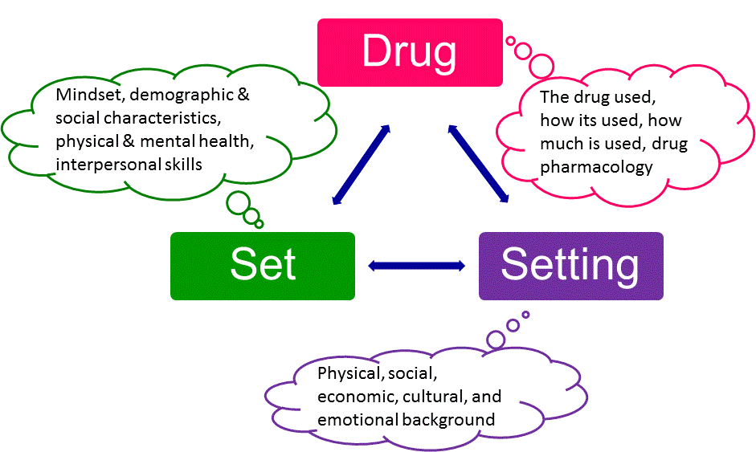
Zinberg, N. E. (1984) Drug, Set, And Setting: The Basis for Controlled Intoxicant Use (New Haven: Yale University Press)
Notes:
KEY MESSAGES
Drug- the drug used, how it is used, how much is used, drug pharmacology, etc.
Set- mindset of the individual, influenced by demographic and social characteristics, as well as physical and mental health, interpersonal skills, etc.
Setting- the background, defined in terms of physical, social, economic, cultural
ASK
Can you think of an example where the person’s DRUG, SET & SETTING puts someone at higher risk of Overdose?
NOTES
Zinberg, N. E. (1984) Drug, Set, And Setting: The Basis for Controlled Intoxicant Use

Slide 13
Continuum of Use
Experimental Use
Situational Use
Abuse
Severely and Persistently Chemically Dependent
Social & Ritual Use
Binge Use
Dependence
Notes:
KEY MESSAGES
Drug use is a complex, multi-faceted phenomenon that encompasses a continuum of behaviors from severe abuse to total abstinence, and acknowledges that some ways of using drugs are clearly safer than others.
People can move back and forth along this continuum.
Or be somewhere with one drug, and another place with a different drug.

Slide 14
Harm Reduction and Sex?
Safer sex work + Safer sex
PWUD and sex work populations may share networks
Or one person could be both
Offer all participants condoms
Share STI prevention + Tx supplies and updates with everyone no one has to feel singled out for being offered safe sex information
Notes:
KEY MESSAGES
Introduce the natural weave of working with PWID, PWUD, and sex workers or people in the life, the trade, or getting by survival.
Remind the room this workshop is not on Sex Work in particular – that’s another workshop
It’s important to recognize from the beginning harm reduction strategies can most certainly be applied to sex work and there’s a pretty good chance the program is already serving commercial or survival based sex workers.
Increase the numbers to reach and engage!
Optional
If there are questions on How to Reach Sex Workers more effectively discuss the Bad Date Sheet (circulating descriptions of customers in the sex industry who commit violence and/or sexual assault).
These sheets are in effect in several programs around the U.S. and beyond and it’s a valuable measure of harm reduction to provide the community.

Slide 15
What Harm Reduction is Not
Harm reduction does not mean “anything goes.”
Harm reduction does not enable drug use or high risk behaviors.
Harm reduction does not condone, endorse, or encourage drug use.
Harm reduction does not exclude or dismiss abstinence-based treatment models as viable options.

Slide 16
What Does Harm Reduction
Look Like?
Risk Reduction
Prevention
Support
Wellness
Advocacy
Linkages
Testing
Education
Safer Sex
Safer Use
HIV/HCV/STIS
Individual Counseling
Group Support
Outreach
SAPs
Prevention Supplies

Slide 17
What are factors related to a person who injects drugs?
Notes:
ASK
What are factors related to a person who injects drugs?
KEY MESSAGES
Other factors include
Hygiene – if a person has access to soap and water and keeping themselves, their clothing, and environment clean or without contamination
Poor water supply – if there is sterile or running water available to dissolve the drugs
What type of drug – if it is powder, pills, gooey “black tar”, cocaine or methamphetamine
How long the drug continues to take effect – ‘short or long high’ (ex: cocaine is short high, possibly requiring more frequent use to sustain effect
What the drug is cut with – household cleaners or otherwise poisonous and not designed for human consumption
Using used needles – only have one left (confiscated, busted, hadn’t a chance to visit NEP, no where to put a grip of gear (homeless, on foot).
17

Slide 18
Contributing Factors & Harms
Physical
    Poor health outcomes
    Violence
    OD
Psychological
    Depression
    Isolation
    Stigma
Social
    Relationship issues
    Lack of community
    Isolation from community
Spiritual
    Isolation
    Not connecting to life
Economic
    $ to acquire drugs
    Loss of housing
    Loss of or trouble finding jobs
Legal
    Discrimination
    Arrest
    Incarceration
Notes:
TRAINER INSTRUCTIONS
Re-cap about how Contributing Factors & Harms all interconnected.
Give examples under each heading of how these factors may both contribute to peoples drug use and also get in the way of them using more safely, reducing or managing their use or stopping using drugs.

Slide 19
ACTIVITY:
Whys and Harms
Notes:
Refer to Scenarios Handout
ACTIVITY INSTRUCTIONS
Assign groups of three or have them “count off” and cluster into small groups
Assign one scenario per group
Go to next slide

Slide 20
Activity Discussion Q’s
What are possible harms you anticipate in relation to drug use behaviors, and overall wellness?
What contributing factors may lead to high-risk behaviors and associated harm?
What strategies can people in the scenarios adopt to reduce harms and decrease risk in the moment?
Explore the possible “whys” someone is using certain drugs/alcohol.
Notes:
Keep this slide up during the Activity.
ACTIVITY INSTRUCTIONS
Have groups brainstorm 5-7 minutes
One participant from each group report back two (2) key points from this Activity Discussion Q slide
Allow for a brief discussion
KEY MESSAGES
Some reasons people use drugs
Physical- pleasure, coping, physical pain relief
Psychological- pleasure, coping
Social- belonging to group, social lubricant
Economic- cheaper and/or easier to access than healthcare, allows one to maintain employment
Some harms that may be presented, which can be linked to contributing factors:
Physical- HIV, hepatitis C, overdose
Psychological- mental illness, psychosis
Social- compromised relationships, social stigma and isolation
Economic- loss of money, employment, public benefits
Legal- arrest, incarceration
Political- loss of political power (e.g. voting, political representation, laws that impact drug users such as the ban on federal funding for syringe exchange)
Ex: Harm reduction strategies
Overdose prevention programs
Syringe access programs; access to safer injection equipment
Access to HIV & HCV testing and treatment
Education around safer injection, HIV, HCV, “drug, set, setting”
Client-centered approach to drug use behaviors – “meeting people where they are”, providing appropriate linkages and referrals to meet individual need and circumstance
Access to buprenorphine treatment, methadone maintenance, moderation management support, abstinence-based treatment, other
Optional
Have Newsprint prepared with sections: WHYS/HARMS/FACTORS/STRATEGIES and scenario # on each sheet

Slide 21
Stages of Change
Transtheoretical Model of Behavior Change
Pre-Contemplation
“Not considering it”
Contemplation
“Thinking about it”
Preparation
“Planning to do it”
Action
“Doing it”
Maintenance
“Staying with it”
Return/Relapse
“Stop doing it”
Notes:
KEY MESSAGES
Stages of Change is also called the transtheoretical model of behavior change
There are six stages that make up the process of change
We all go through the process of change shown in the stages of change model.
The stages of change model is not a purely linear model.
People move from one stage to the next at their own pace, can go backwards to a previous step in the process, and can relapse at any time.
An individual may be at different stages for different behaviors (example: someone might be at pre-contemplation around their crack use, but at maintenance around their heroin use).
Relapse or return is a normal part of the process of change that is to be expected.
Relapses help us learn how to make enduring change.
Planning for barriers in the preparation stage and beyond can help prevent the likelihood of relapsing/slipping in the future.
Social support is an important part of the process of change.
MI helps an individual move through the process of change. It does so using different techniques at different stages.

Slide 22
PRE-CONTEMPLATION “Not Considering It”
CONTEMPLATION “Thinking About It”
PREPARATION “Planning To Do It”
ACTION “Doing It”
MAINTENANCE “Staying With It”
RETURN/RELAPSE “Stop Doing It”
Notes:
TRAINER INSTRUCTIONS
Use same thread for the 6 stages: smoking cigarettes, for example:
PRE-CONTEMPLATION “Not Considering It” – I buy a pack of smokes in the morning and have a few with my coffee
CONTEMPLATION “Thinking About It”-- I hear smoking kills, I know this, I’m just starting to think to slow down maybe
PREPARATION “Planning To Do It” -- I got a plan: I chew that gum for 2 weeks, I stop smoking before 12 noon, I have an end-date
ACTION “Doing It” – I’m not smoking, one day at a time!
MAINTENANCE “Staying With It” – Some say you need 6 months of doing something for real before you hit ‘maintenance’
RETURN/RELAPSE “Stop Doing It”-- – Lapse is doing that one thing maybe once, ReLapse is when you resume the behavior; I bum a smoke from a gal at a party after having not smoked for 6 months (Lapse), I start buying a pack in the morning to go with my coffee (ReLapse). Re/Lapse can come in handy to re-calibrate Preparation: maybe I can’t handle coffee without cigarettes so my next run at this includes drinking tea in the morning (Action) til I feel confident I can have the coffee without cigarettes for two seasons (welcome back to Maintenance)
22

Slide 23
Principles of Harm Reduction
Health and Dignity
Participant-Centered
Participant Involvement
Participant Self-Rule
Recognize Inequalities & Injustices
Practical and Realistic
Notes:
23
TRAINER INSTRUCTIONS
The next six slides will help explain key principles of harm reduction.

Slide 24

(1) Focus on Health and Dignity
Establishes quality of individual and community life and well-being as the criteria for successful
interventions and policies.
foto by George Hodan
Notes:
ASK
What does ‘Health and Dignity’ look like?
KEY MESSAGES
Calls for the non-judgmental, non-coercive provision of services and resources to people who use drugs and the communities in which they live in order to assist them in reducing attendant harm.
24

Slide 25
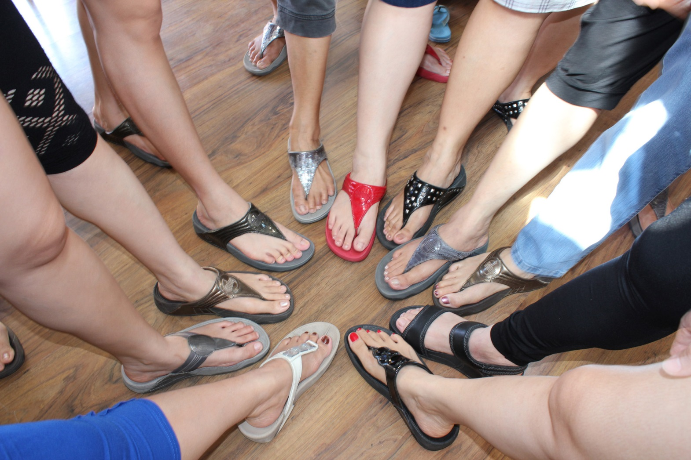
(2) Participant-Centered Services
Non-judgmental and non-coercive provision of services and resources.
foto by Maliz Ong
Notes:
KEY MESSAGES
Low threshold service provision: provide options, work with program participants.
Think about where, when, how services are provided to be the most Accessible & Appropriate for the people the services are for.
25

Slide 26
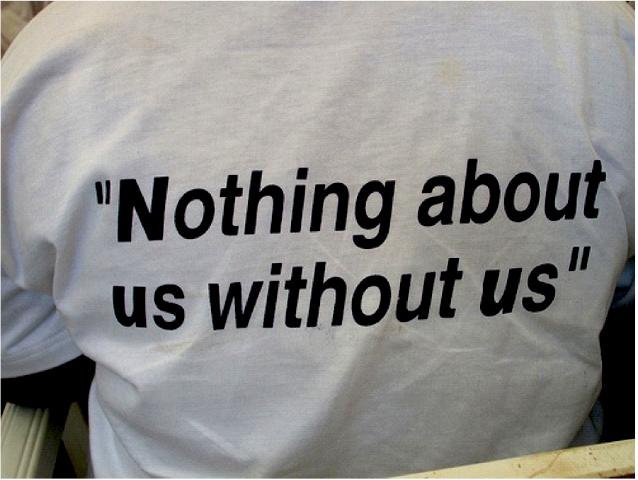
(3) Participant Involvement
Ensures people have a real voice in the creation of programs and policies designed to serve them.
Notes:
KEY MESSAGES
Ensures that people who use drugs and those with a history of drug use routinely have a real voice in the creation of programs and policies designed to serve them.
26

Slide 27
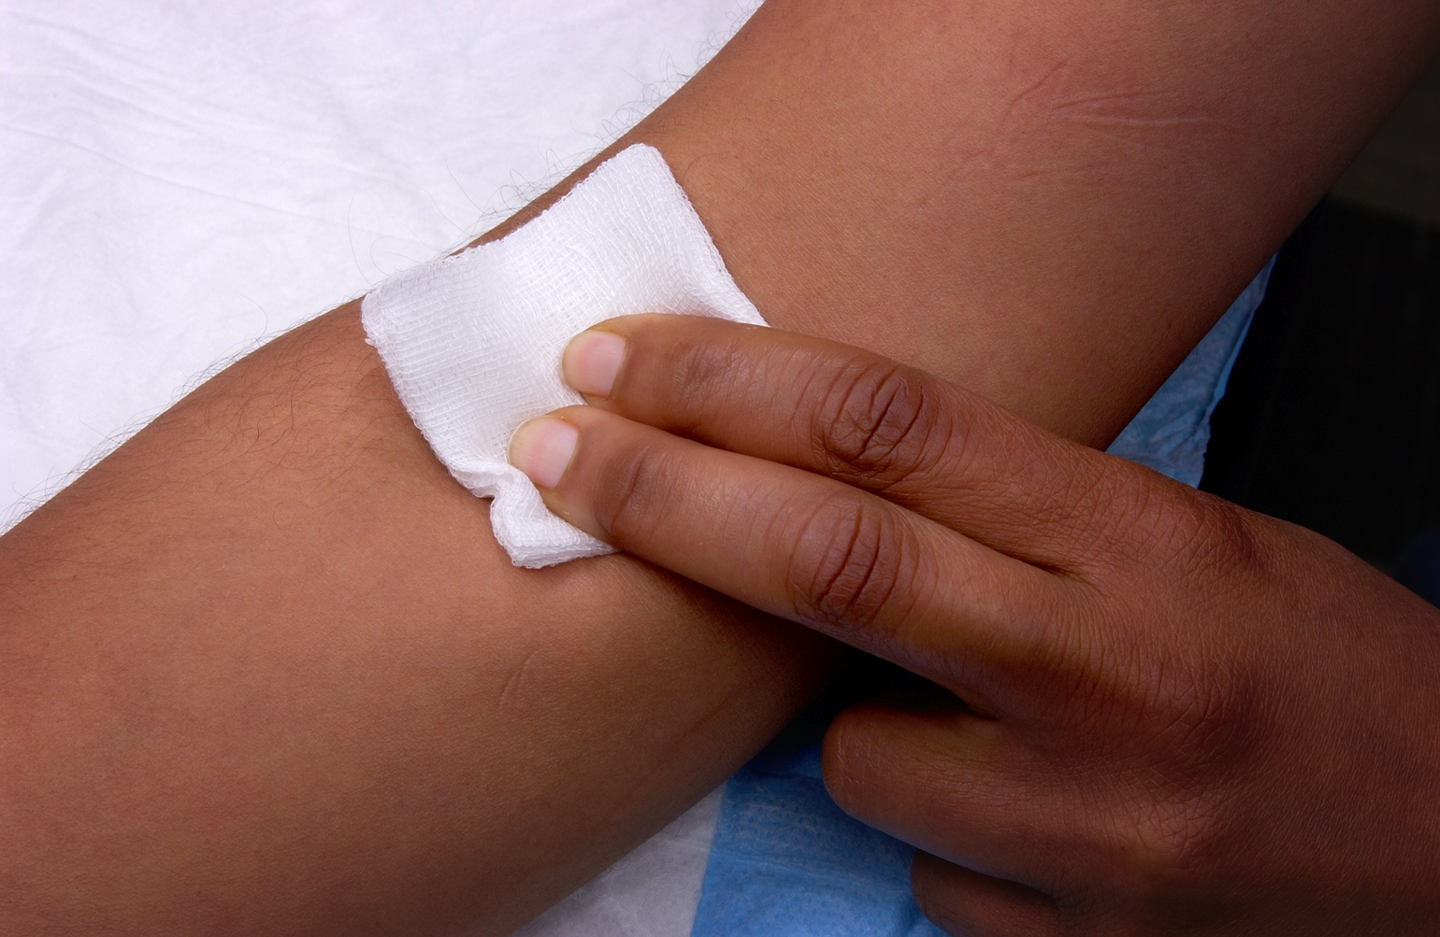
(4) Participant Autonomy
Affirms people who use drugs themselves as their own primary agents of change .
foto by CDC/James Gathany
Notes:
KEY MESSAGES
PWUDs are experts in their own lives.
People will change when ready and circumstances allow.
Empower PWUDs to share information and support each other in strategies which meet their actual conditions of use.
27

Slide 28
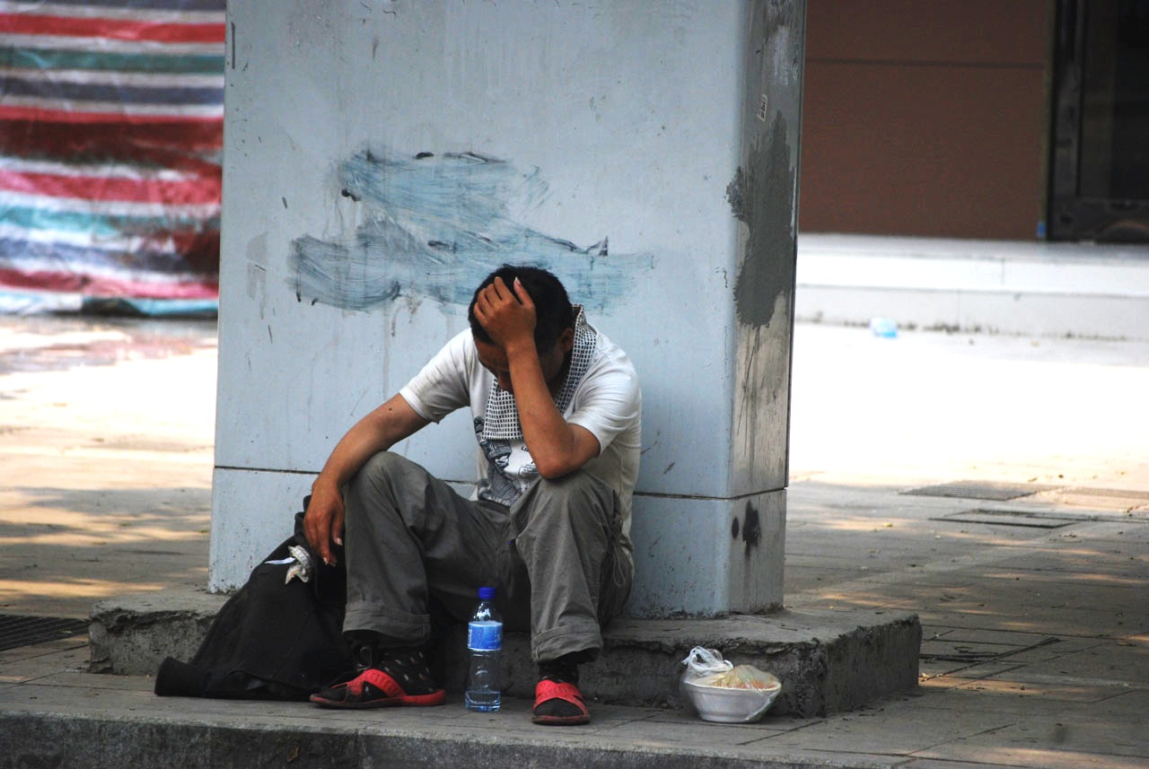
(5) Sociocultural Factors
Recognizes the various social inequalities which affect both people's vulnerability to and capacity for effectively dealing with potential harm.
foto by Peter Griffin
Notes:
KEY MESSAGES
Harm Reduction recognizes the realities of poverty, class, racism, social isolation, past trauma, sex-based discrimination and other social inequalities affect both people’s vulnerability to and capacity for effectively dealing with drug-related harm.
ASK
How do these factors influence people’s ability to reduce harm; access services; manage drug use?
NOTES
SES: Socio Economic Status

Slide 29

(6) Pragmatism and Realism
Does not attempt to minimize or ignore the real and tragic harm and danger associated with licit and illicit drug use or other risk behaviors.
HRC Hepatitis C Prevention Poster
Notes:
KEY MESSAGES
Accepts, for better and or worse, that licit and illicit drug use is part of our world and chooses to work to minimize its harmful effects rather than simply ignore or condemn them.
29

Slide 30
ACTIVITY:
Practicing the Principles of Harm Reduction
Notes:
TRAINERS PREP
Hang prepared newsprint of each principle of harm reduction around the room:
Health and Dignity
Participant-Centered Services
Participant Involvement
Participant Autonomy
Sociocultural Factors
Pragmatism/Realism
ACTIVITY INSTRUCTIONS
Remind the room of “group guidelines”, such as confidentiality, as some may be disclosing personal information.
Go to next slide.

Slide 31
Activity Slide:
Key Principles of Harm Reduction
      Health and Dignity
      Participant-Centered Services
      Participant Involvement
      Participant Autonomy
      Sociocultural Factors
      Pragmatism/Realism
Notes:
31
Keep this slide up during the Activity
ACTIVITY INSTRUCTIONS
Ask each person to move to the Principle that resonated with them the most.
Then ask them to move what Principle that challenged them the most.
Ask each person to return to seats.
Go through each principle, asking for 2-3 volunteers to offer an example of something that resonated, and an example of how they felt challenged.
Ask the group to discuss why they chose this particular principle (why is resonated) and have group members discuss for 5 minutes maximum.

Slide 32
Harm Reduction is…
A holistic approach to working with
people at higher-risk in relation to HIV,
drug use, and sexual behaviors.
Programs can be:
Low-Threshold, Convenient, Evidence-based
Providers can be:
Positive - Honest - Productive
Pragmatic - Client-centered - Without Bias
Notes:
KEY MESSAGES
In summary:
Providers probe into very private, personal and intimate details from the people they are serving.
Providers can provide information and linkages to services that participants might otherwise never seek due to stigma, barriers (transportation costs, location), or not believing they were worth the self-care.
Harm reduction programs aim to be low-threshold!
Low-threshold means reducing or removing as many barriers as possible in order for vulnerable individuals to access health services.
When providers create an environment that is positive, honest, productive, and without judgement or bias, they will have a more engaging relationship with clients.

Slide 33
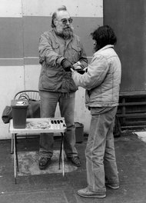
Syringe Access Programs
Our Roots in Harm Reduction!
“How does this work?”
“You give me an old one, I give you a sterile one, and it keeps your butt alive”
Doug Wilson
Dave Purchase handing out syringes on his own in Tacoma, Wash., in the late 1980s. New York Times, January 27, 2013
Notes:
KEY MESSAGES
Harm reduction stems from syringe exchange.
NOTES
Foto from the New York Times, January 27, 2013, featuring Dave Purchase handing out syringes on his own in Tacoma, Washington in the late 1980s.
“This is life and death. There were unnecessary deaths, unnecessary and preventable deaths.”
Dave Purchase has been regarded as the Godfather of Syringe Exchange in the United States (1940~2013).

Slide 34
Brainstorm: Interventions
Education
Access
Support
Linkages
How can an agency support participants in reducing risk behaviors using these four interventions?
Notes:
TRAINER INSTRUCTIONS
Allow group to brainstorm each intervention.
Offer suggestions/ideas of ways an agency (or service provider) can apply different approaches within these four categories to reduce risk behaviors, and promote positive behavioral change for PWUD/PWID.
KEY MESSAGES
Education: safer injection, safer sex, OD, HIV/HCV messages, tx, etc.
Access: distribution of supplies, syringe access, safer sex supplies, case management, housing assistance, etc.
Support: MI, group support, etc.
Linkages: buprenorphine treatment, MMT, other AOD Treatment options, HIV/HCV care/tx, medical and mental health care
Optional
Use newsprint and markers to write down brainstorm ideas, by category.
Facilitate input in large discussion without newsprint if time is short.

Slide 35
Syringe Access:
Reduction in HIV Incidence
Syringe access is the most effective, evidence-based HIV prevention tool for people who inject drugs.
Federal agencies for national health such as the CDC, SAMHSA, HRSA, and NIDA conclude the use of sterile syringes prevent the spread of HIV and other blood-borne infectious diseases.
PWID have reversed the course of the AIDS epidemic by using sterile syringes and harm reduction practices.
Science-based Literature Review on SEPs in the United States 1996-2008. Joanna Berton Martinez
Notes:
KEY MESSAGES
Researchers say that this is the great success story of HIV Prevention.
The biggest successes we have managed to have in HIV transmission is with perinatal transmission and transmission among PWID.
Syringe access programs are the most effective, evidence-based HIV prevention tool for people who use drugs.
Seven federally funded research studies found that syringe exchange programs are a valuable resource.
In cities across the nation, PWID have reversed the course of the AIDS epidemic by using sterile syringes and harm reduction practices.
35

Slide 36
Reduction in Hep C Transmission Risk
Almost 1/3 of IDUs (31.8%) report sharing
syringes and other equipment in U.S.*
Many participants of SAPs are referred to Hep B vaccination series and Hep C treatment.
Safer injecting equipment education from an SAP assist PWID who do not have Hep C, to stay that way.
*HIV-Associated Behaviors among Injecting Drug Users—
23 Cities, United States, May 2005-Feb 2006
MMWR 2009
Notes:
KEY MESSAGES
Syringe Access Programs (SAPs) can help reduce incidents of sharing through providing sterile equipment and supplies, safer injection education, exploring barriers for the individual, and increasing self-efficacy.
Historically, SAP focus was on HIV prevention, leaving many long-time injectors infected with chronic Hep C – sometimes undetected for years.
For more than ten years, Hep C has been ‘on the map’ – if not, this percentage (31.8%) would be much higher.
More people now getting tested, treated, connected to care, and NOT SHARING syringes and equipment.
MORE NOT SHARING THAN SHARING.
Last bullet: focus on new injectors, discuss testing & treatment as prevention.
36

Slide 37
The spectrum of harm reduction services
Paths forward
HIV-related interventions
Syringe access
HIV/HCV screening
Patient navigation
Risk reduction counseling
Medication Assisted Treatment (MAT)
Buprenorphine
Methadone
Support services
Housing/shelter
Mental healthcare
Support groups
Healing services
Overdose Prevention
Naloxone
CPR training

Slide 38
It’s Not Just Syringes:
Benefits of Syringe Access
Detox and drug treatment programs
Medical, dental & mental health services
Bad Date Sheet
Hep A + B Vaccinations
HIV/Hep C services
Housing services
Safer sex supplies & education
Overdose prevention
Prevention for non-injectors
Notes:
KEY MESSAGES
Referrals to detox, rehab, domestic violence (DV) services
Safer sex supplies, Hep A + B vaccinations
A Bad Date Sheet describes violent and abusive customers in the sex industry. Some SAPs provide these with other travel size hygiene, safer sex/drug use supplies.

Slide 39
Provider Tips
Do say you don’t know when you don’t know.
Do celebrate small wins.
Do roll with the punches.
Do set limits.
Do keep your humor.
Do learn from your mistakes.
Do take care of yourself.

Slide 40
Avoid becoming a rescuer.
Avoid taking it personally.
Avoid the assumption you have the same goals as the client.
Avoid trying to do this alone.
Notes:
KEY MESSAGES
“Don’t take it personally.” Easier said than done☺
Avoid oversharing your business; it’s not about you.

Slide 41
What suggestions
would you add?
Notes:
ASK
What suggestions would you add?
41

Slide 42
Reflective Practice: Harm Reduction
Identify
Identify specific areas where you may need more support in applying specific harm reduction interventions.
Explain
Describe to a colleague what harm reduction is in your own words. Has this changed from this morning’s introduction exercise?
Apply
Does your agency follow the six main principles of harm reduction? How can you integrate these harm reduction messages into daily work with clients?
Notes:
Refer to Worksheet
TRAINER INSTRUCTIONS
These are a few ideas to apply the day’s workshop into practice.
Encourage participants to share in supervision, with peers, and/or with colleagues at their agency.

Slide 43
Closing & Evaluations
Anonymous Surveys:
Put completed surveys in the folder
Notes:
Refer to Blank Evaluation Handout
TRAINER INSTRUCTIONS
Ask participants to complete the anonymous survey.
Provide a large manila envelope or folder for participants to put their completed surveys.
Optional
Plus/Delta is a closing exercise where every person can give one example of what worked or was effective about the day’s workshop, and one suggestion that could improve the workshop.
Each person has a turn with the option to say “Pass.”
The purpose of this closing exercise is to give each participant a chance to share their opinion verbally if writing is not how they express themselves best.
Avoid having discussion on responses, this exercise is meant to move forward to wrap up the day.

Slide 44
HRC thanks you for participating in this workshop!

